Slide 1

Digital Safety for Library Workers:
Prevention strategies & removing personal data from internet directories
Library Freedom Project presents:
NAME
Position
Email
Notes:
Hello everyone, thank you for joining MLA’s Library Information Technologies Section (LITS) today.
We do encourage all of you to say hello to each other, and to submit your comments or suggestions in the Chat, and to direct any questions to LITS via the Q&A box.

Slide 2
Introductions
Discussion Leader:
Name (Pronouns), Role
Chat Moderators:
Name (Pronouns), Role
Name (Pronouns), Role
Notetakers:
Name (Pronouns), Role
Name (Pronouns), Role
Contact us: email
Notes:
As we begin, I would like to introduce myself.
My name is XX,, my pronouns are she/her, and I am [position title].
I am also a Member of Library Freedom Project, an advocacy organization dedicated to empowering communities and equipping our communities with tools needed to mitigate the harms of digital surveillance.
I am joined by several Members [ORG AFFILIATION] who are key to making this program run today…

Slide 3
A few bits of housekeeping…
To maximize privacy, LFP is not recording this session. We ask attendees to refrain from recording this session, as suggestions and concerns shared may be sensitive.
Exercise discretion and respect each other’s privacy. It is our hope that everyone will leave this session with new ideas and practical tips to apply and share. If you are sharing these ideas, please do not publish the name or affiliation of the source without permission (LFP is an exception, of course!).
The topics raised in today’s conversation are alarming and ongoing. It is possible that there may be folks among us today who are at greater risk; are close to those who are; or, may actively be experiencing harassment or harm. Please be sensitive to this reality and of our colleagues.
Following today’s meeting, LFP will send out an anonymized list of the additional ideas shared by participants, and a consolidated list of links referenced in this presentation.
Notes:
As we get started, there are a few bits of housekeeping that I’d like to address:
To maximize privacy, LFP is not recording this session. We ask attendees to refrain from recording this session, as suggestions and concerns shared may be sensitive.
Exercise discretion and respect each other’s privacy. It is our hope that everyone will leave this session with new ideas and practical tips to apply and share. If you are sharing these ideas, please do not publish the name or affiliation of the source without permission (LFP is an exception, of course!).
The topics raised in today’s conversation are alarming and ongoing. It is possible that there may be folks among us today who are at greater risk; are close to those who are; or, may actively be experiencing harassment or harm. Please be sensitive to this reality and of our colleagues.
Following today’s meeting, LFP will send out an anonymized list of the additional ideas shared by participants, and a consolidated list of links referenced in this presentation.

Slide 4
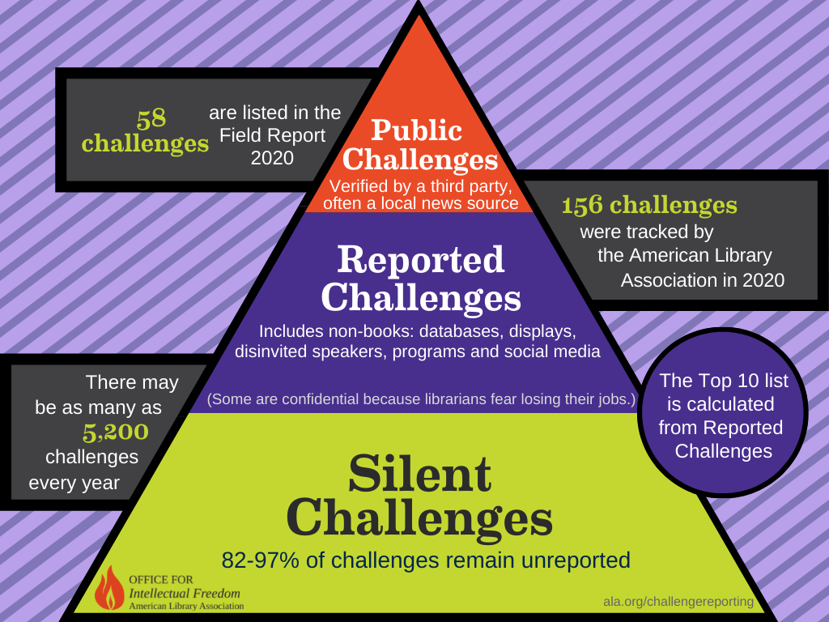
Challenges & Librarianship
ALA Letter of Concern to FBI Regarding Threats of Violence in Libraries
ALA Cyberbullying and Doxxing Resources
ALA Office for Intellectual Freedom Newsletter archive
ALA Office for Intellectual Freedom Challenge Support
MLA IFSRC & MLS Intellectual Freedom LibGuide for MA Libraries
Targeting of specific groups of people including: LGBTQIA+, Asian American Pacific Islander, BIPOC communities
Notes:
There is no easy way to introduce the issues that we have been facing in our communities and within our profession.
Over the last year or so, we have been experiencing a number of attacks on library services, and on the people who make them run, including administrators and library staff. Those of us in our profession who are in these roles, and may demonstrate allyship or belonging to groups being targeted by White Nationalists, are vulnerable to varying levels of intimidation. It is a very difficult and scary time for many people in our field.
In addition to the “formal avenues” available to individuals and groups to challenge library services, alarmingly, there is also organized efforts by various right-wing groups – such as one’s being led by Moms for Liberty – who are using “informal avenues”, such as intimidation to force their agenda. Moms for Liberty, and groups like them, are offering training to their supporters on how to identify, mine social media and the internet, in order to bully or intimidate public service workers, including educators, teachers and librarians.
This is growing into such a problem that ALA issued a ALA Letter of Concern to FBI Regarding threats to library workers;
Acknowledged this by creating a page dedicated to cyberbullying and anti-doxxing resources for library workers;
Is reflected in the weekly newsletter updates shared by ALA’s OIF.
It is a very difficult time. If your library needs support on Challenges that you are facing, there are resources available on ALA’s Office for Intellectual Freedom website; and MLA’s stellar IF/SRC teamed up with MLS to offer a localized Intellectual Freedom LibGuide for MA Libraries.
While much of the animosity seems to be framed around “book challenges,” it cannot be understated that this is about actual lives, and our republic is at such a tipping point that harassment of public service workers through doxing and cyberbullying is being adopted as a practice.
_________
(If it makes sense to say this..
We are seeing this happen in all areas of civic life; such as the harrowing, upsetting experiences that former poll workers Ruby Freeman and Shaye Moss testified to as part of the January 6th Committee hearings over the Summer: https://www.nytimes.com/2022/06/21/us/politics/jan-6-trump-threats.html or https://www.youtube.com/watch?v=23dn9VXWCsg)
This is growing, https://www.accessnow.org/digital-security-helpline-in-2020-lgbtq-groups-are-facing-more-online-harassment-than-ever/

Slide 5
Prevention Strategies
Notes:
So, today’s talk is focused on providing library workers with a framework and basic considerations that you can apply back in your own lives, to prepare for online harassment that you may experience as a result of your role.

Slide 6
Harm Reduction/Harm Minimization Tips
Take the approach of: WHEN my account[s] are hacked/doxed/compromised rather than IF my account[s] are hacked/doxed/compromised.
Take a look at what is already publicly available about you online.
Read up on policies of the accounts that you already have; tighten Settings.
Identify who you can trust and create a plan.
General Resources:
Electronic Frontier Foundation Surveillance Defense kit
Library Freedom Project: Anti-harassment guide

Slide 7
Threat Modeling & Digital Security
Notes:
While there is a lot of good general advice out there, unfortunately there is not really a one-size fits all approach to security. We all have our unique considerations, risk tolerances, resources, and vulnerabilities. So while general tools can be a helpful place to start, it is a good idea for folks to also consider your own unique situation.
Threat Modeling can be very useful because it is important that you organize yourself so that you can take preventative actions.

Slide 8
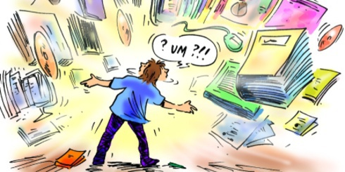
Data, Data Everywhere…

Slide 9
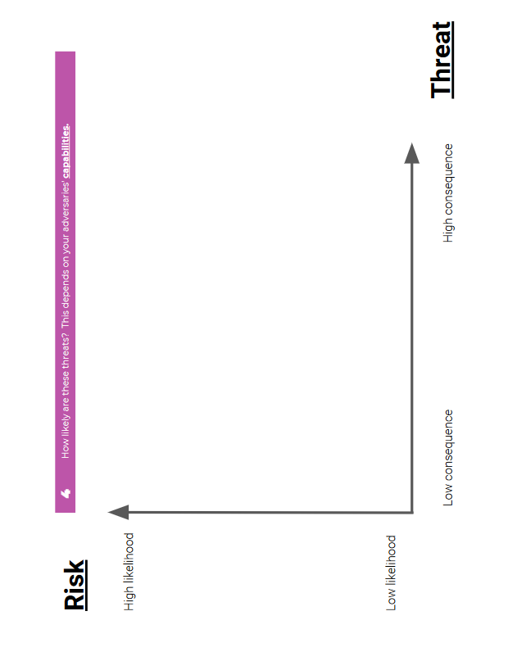
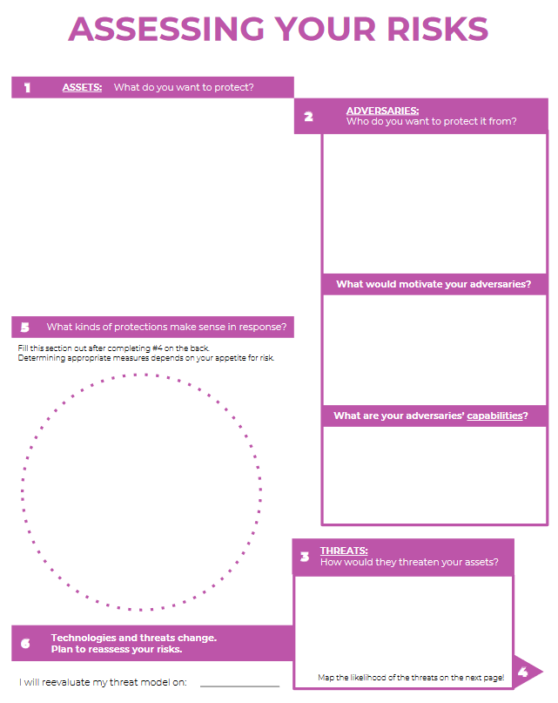
A Look at Threat Modeling
Notes:
Threat modeling is a framework that helps you to identify what you need to protect; and, to take personalized, actionable steps towards your goal of reducing your risk for harm.
It is impossible to protect against everything, so creating a Threat Model allows you to focus on what is most important for your safety.
It is also important that you are able to give consideration to the risks that you are willing to take, and the consequences of those decisions.
This knowledge helps you prioritize, and develop a plan.

Slide 10
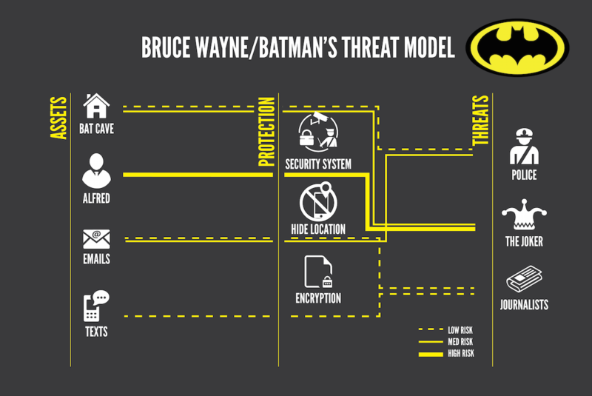
Threat Model Example
Q1: What am I protecting?
Q2: Who are my adversaries?
Q3: What are the consequences if I fail?
Q4: How likely are these consequences?
Q5: How can I address the most likely risks?
Notes:
Let’s consider the portrayal of Bruce Wayne/Batman…
Q1: Who or what is Bruce Wayne/Batman protecting? (Assets) [bat cave, alfred, emails, texts]
Q2: Who are Bruce Wayne/Batman’s adversaries? [Police, the Joker, journalists]
Q3: What are the consequences Bruce Wayne/Batman fails? [owe a lot of money due to damage!]
Q4: How likely are these consequences?
Q5: How does Bruce Wayne/Batman address the most likely risks? [Security system, secret location, encryption… he also is not honest…]

Slide 11
Activity: Library Workers Threat Model
Q1: What am I protecting?
Q2: Who are my adversaries?
Q2a: What would motivate adversaries?
Q2b: What are my adversaries capabilities?
Q3: How will my adversaries threaten my assets?
Q4: How likely are these consequences?
Q5: What kinds of protections make sense in response?
Remember: Technologies & threats change: reassess.
Notes:
Okay, so now that we all have a basic understanding of how harm reduction and threat modeling works, let’s try to assess risks and answer this worksheet together.
To begin:
Q1: What personal assets would a library worker want to protect?
(location, address, email, phone number, friends & family, identification numbers)
Q2: Who are our Adversaries?
Knowing who is targeting you, and why they are working against you, is important.
Are they capable?
Q3: How would any of our adversaries threaten these assets?
(Identity fraud, deportation, locked out of accounts, doxing, harassment)
Q4: How likely are these consequences?
It is important to add that depending on the identities that you hold, you may be at greater risk of harassment and have fewer avenues for support.
Q5: What kinds of protections make sense in response?
And, most importantly, remember that technologies and threats change. Technology and the internet works on a cycle; you, too, must be in sync.

Slide 12
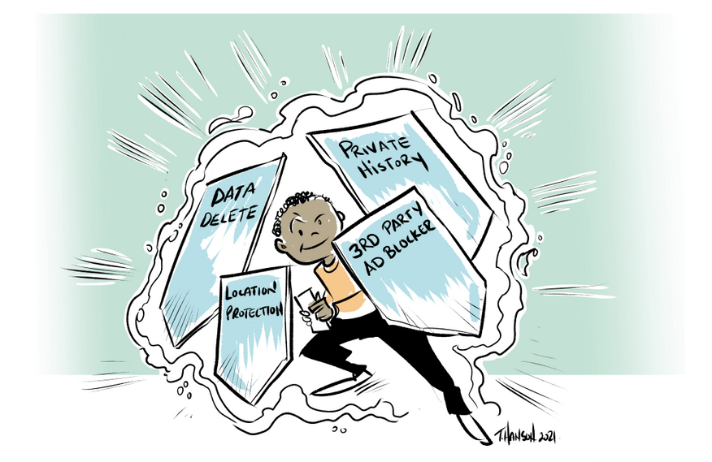
Threat Modeling, Harm Reduction & Digital Security: Out of Box Solutions
Crash Override Automated Cybersecurity Helper
Hackblossom’s DIY Feminist Cybersecurity
Data Detox Kit
DIY Online Safety
iHeart Mob Resources
Security in a Box
Access Now’s compilation of resources
Notes:
I understand that for some, developing a personalized threat model can be overwhelming, or time consuming, and you may prefer “out of box” solutions, or want to explore more options.
There are resources on the web that can help you do some of this work.

Slide 13
Other Considerations?

Slide 14
Removing Personal Data From Internet Directories
Notes:
By having a digital footprint at all, your information has likely already been gathered, packaged, sold and then made available in places that you never consented to. Without privacy protections in place, data brokers have built an extremely exploitative, harmful and lucrative industry at the expense of people and community safety.

Slide 15
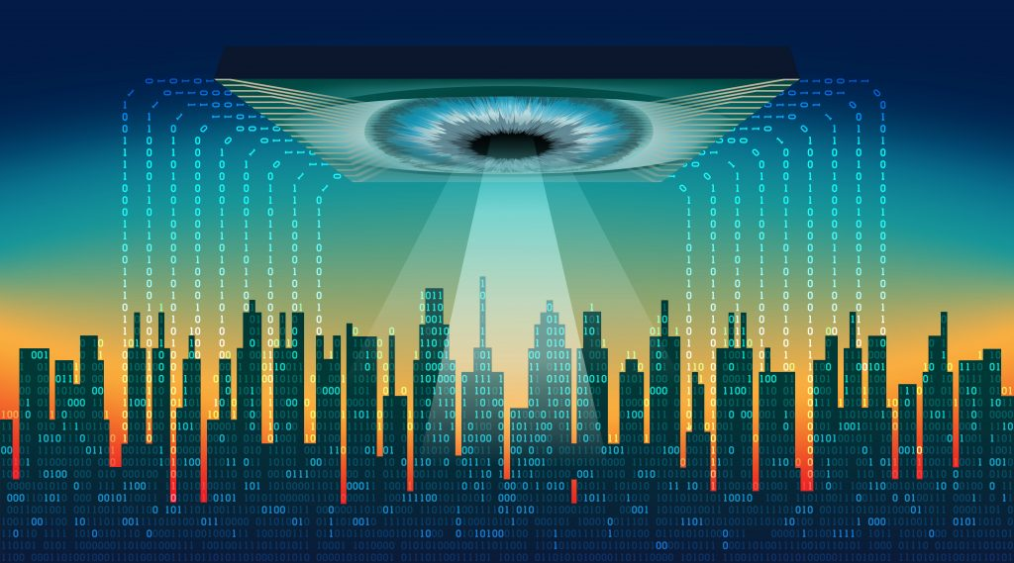
Data Brokers, Corporate Surveillance & the Free Market
Notes:
The data brokers’ industry functions by surveilling and harvesting as much data about everyone as possible.
In addition to gathering data about you from the various tools you use, data brokers are also quite adept at gathering information from public records using online trackers, linking the data to individuals or entities, and then creating new ways to monetize that collection of data.
While we need structural reform to help begin to address these issues, due to public pressure many companies offer ways to opt out of data being shared (not necessarily collected).

Slide 16
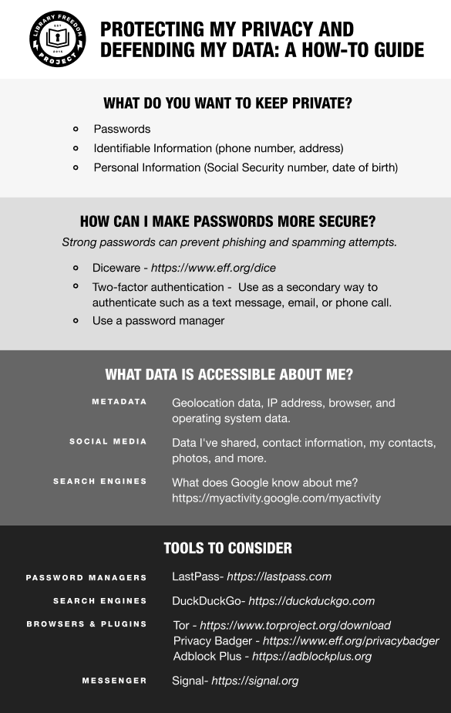
Removing Personal Data From Internet Directories: Links
Background Checks: Just Delete Me
One Rep scan and search
Privacy Rights.org’s Data Brokers list
Library Freedom Project’s list of major data broker removal request pages
Do Not Call Registry
Remove your personal information from Google
“Biggest Bads”: White Pages, Instant Check Mate, Acxiom, Intelius, Spokeo, Been Verified
Get your friends, family, roommates involved with this too!
Notes:
While many companies have made it possible for individuals to opt-out of their practices, it is still an overwhelming task for many people. There are any number of corporations who may have your information, you likely don’t know who they are, and it can be difficult to track down on your own.
Fortunately, there are resources available online that have consolidated links to various “opt-out” pages.

Slide 17
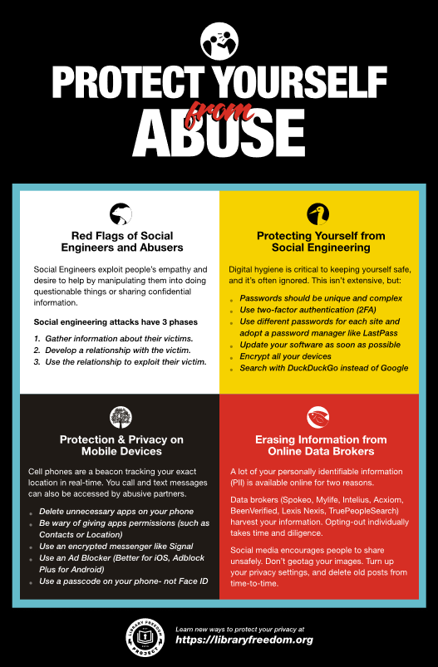
Removing Personal Data From Internet Directories: Action Items
“Google” yourself; check Bing, Yahoo!, etc
Delete (not just deactivate) unused accounts
Lock accounts from “public view”
Voter registration: request your registration data not be publicly visible online
Don’t send images or texts electronically with your Tax ID/SSN/License, registration number visible.
Clean out your inbox[es] & Direct Messages folders
Once you delete, maintain your new level of discretion; data collection is a cycle
Notes:
In addition to submitting opt-out requests to the various Data Broker agencies, there are other considerations you many want to take to limit the chances of your information being collected again.
Additional steps that you may want to consider include…
(gotta love “Individual Responsibility!”)

Slide 18
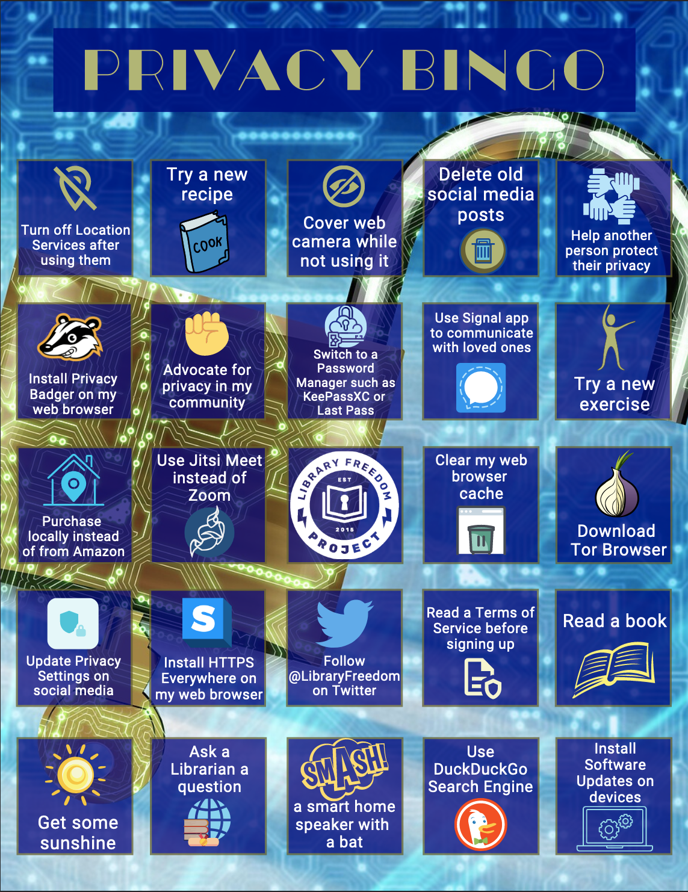
Digital Privacy is a Cycle
Have I Been Pwned?
Set up a Google alert to track references/linking to your name on the internet
Check major brokers regularly
Migrate to Privacy Tools and platforms (check out the Big Tech Alternatives tab on LFP/MLA LibGuide!)
Create unique, tough passphrases. Use a Password Manager like LastPass or Bitwarden.
Do not put more information on line than needed; avoid tagging; do you need to be honest?
Notes:
So, to that end, you must be wondering: how can I keep up with all of these changes?
There are tools that you can use, and steps that you can take….

Slide 19
Other Considerations?

Slide 20
Doxing & Incident Response
Notes:
Okay, so I know that I have spoken a lot about preventative measures that can be taken, and of all of the various risk factors that exist. It is possible that in spite of your best efforts, that one of your accounts ends up compromised and a malicious actor or actors are spreading your information online.

Slide 21
Doxing is the unauthorized retrieving and publishing, often by hacking, of a person’s personal information, including, but not limited to, full names, addresses, phone numbers, emails, spouse and children names, financial details. Causing fear, stress and panic is an objective of doxing, even when perpetrators think or say that their objective is “harmless,” and this can result in physical harm.
Defined by Women’s Media Center
Notes:
Doxing, as defined by the Women’s Media Center, is the unauthorized retrieving and publishing, often by hacking, of a person’s personal information, including, but not limited to, full names, addresses, phone numbers, emails, spouse and children names, financial details. Causing fear, stress and panic is an objective of doxing, even when perpetrators think or say that their objective is “harmless,” and this can result in physical harm.
I did add the ending part in red, as it is important to recognize the relationship between the impact of the digital on the physical.
It is very serious when Doxing happens, and can have a lot of unexpected consequences.

Slide 22
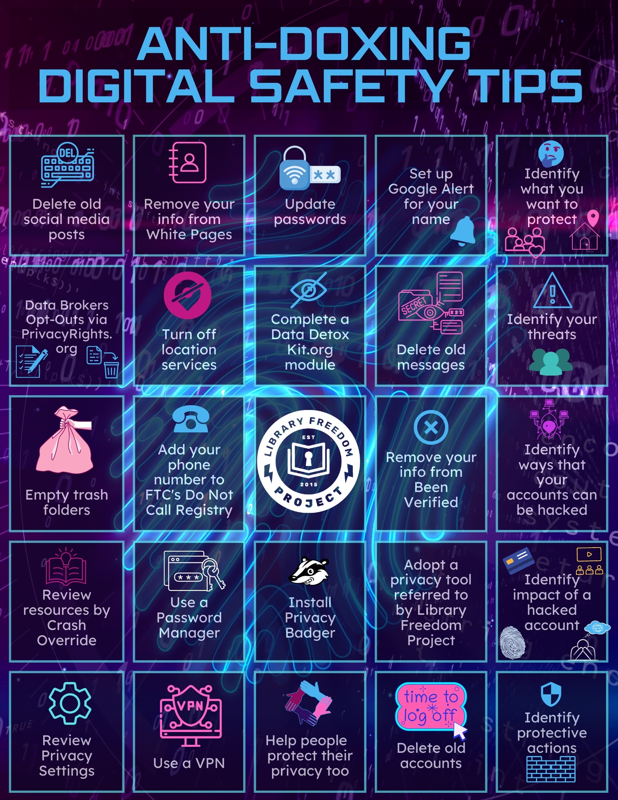
Anti-Doxxing Resources
Crash Override: So You've Been Doxed
Equality Labs: Anti Doxing Guide for Activists
Access Now: Self-Doxing Guide
Digital First Aid Kit
Upcoming: Keep an eye out for more resources coming from Library Freedom Project!
Notes:
There are resources available online to help people who are experiencing a dox, or are trying to protect themselves against one.
Some of these resources include…

Slide 23
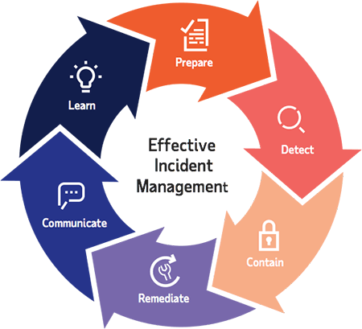
Incident Response Cycle
Document everything. Take screenshots, timestamp, make sure to capture URLs..
Are you safe?
Tell someone, and report the incident.
Remove your information; decide which accounts to deactivate or lock; update passwords to something new.
Write everything down.
Go Offline.
Do you need to relocate?
Monitor the situation (create “fake accounts”; set up alerts)
Make a report on the sites where your doxed information is shared (ex: Pastebin.com/contact)
Notes:
If you are experiencing a dox, or know someone who is, general advice on how to respond includes…

Slide 24
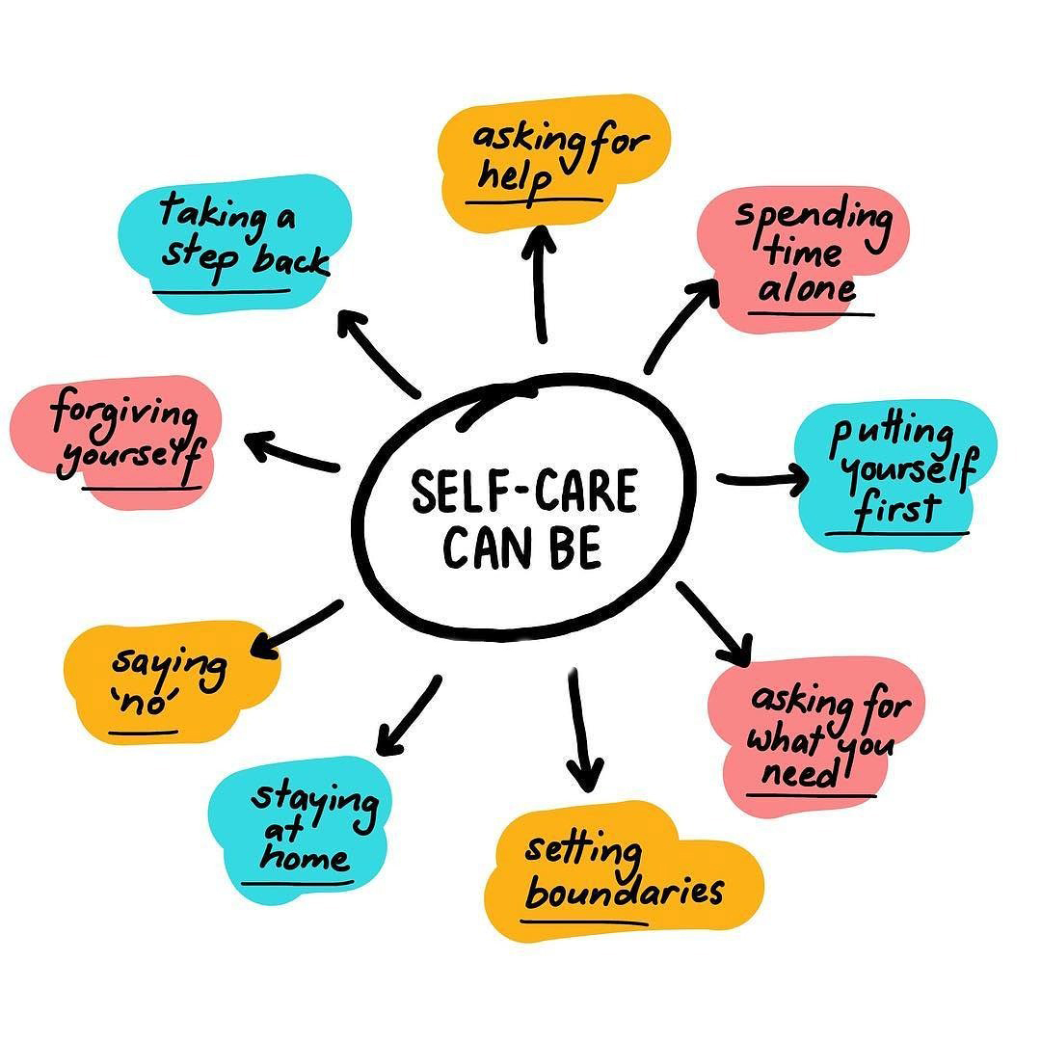
Self-Care Tips & Resources
Resources?
Tips?
Notes:
Finally, I know that much of what I have shared today is overwhelming and stressful, particularly given our broader climate.
If you are experiencing harassment or harm, it is important to get help when you are able, and to take steps to care for yourself as best you can.
I think that it is important that we take some time to process some of this, and I would like to invite all of you to share resources or tips that you use to help decompress, find joy, find support.
(crowd source from attendees!)

Slide 25
Questions?
NAME
Position
Email contact
Notes:
Revisiting internet account basics: passphrases, usernames, cloaking, account management
Locking down social media: advanced tips, beyond generic advice

